Slide 1
ENSEMBLE LEARNING FOR PREDICTION OF MENTAL HEALTH STATUS IN EMPLOYEES: TOWARDS A STRESS-FREE WORK ENVIRONMENT
Review 03
GUIDE: Dr. Balasaraswathi V R
Name: Gandla Pravallika
Reg no: 20BCE1277

Slide 2
INTRODUCTION
Workplace mental health is increasingly recognized for its impact on productivity and well-being, focusing on stress, anxiety, and burnout's effects.
A predictive model integrates individual and organizational factors to prevent issues escalation, aiming for employee well-being and organizational success.
Components involve literature analysis, risk identification, and predictive framework development with technology. Ethical considerations prioritize privacy and confidentiality for a supportive workplace culture.

Slide 3

PROBLEM STATEMENT
The problem statement revolves around various stressors in individuals' lives, including work pressure, societal expectations, and psychological disorders like depression, anxiety,leading to heightened stress levels.

Slide 4
RESEARCH OBJECTIVE
Develop predictive framework for mental health treatment necessity in modern workplace using advanced technologies like predictive analytics for improved accuracy.
Identify industry-specific risk factors, especially those related to remote work, and recognize intersectionality of individual identities in mental health dynamics.
Explore how company culture affects mental health and employee happiness, aiming to understand and suggest ways to create supportive workplaces.

Slide 5
PROPOSED SYSTEM
The system combines predictive analytics, surveys, and technology to proactively manage workplace mental health. It uses machine learning for predictive modeling and standardized surveys for data collection, prioritizing privacy and ethics.
It prioritizes data privacy and ethics, ensuring compliance with standards, and offers a centralized database with real-time monitoring dashboards to facilitate informed decision-making.

Slide 6
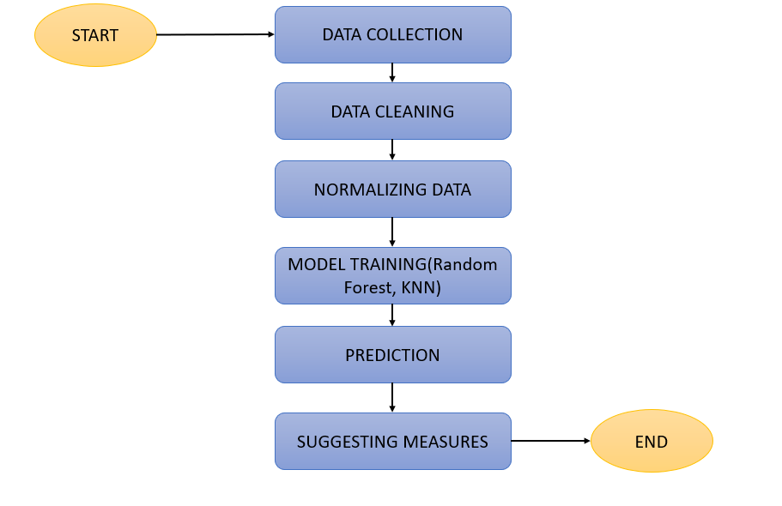
PROPOSED SYSTEM DIAGRAM

Slide 7
LIST OF MODULES
Data Collection
Data Pre-processing
Feature Extraction
Machine Learning Algorithms
Model Training
Validation and Testing

Slide 8
Data Collection:
The data collection process involves gathering relevant information related to employee mental health status. This could include survey data, demographic information, employment history, and self-reported mental health assessments. Data may be collected through internal surveys, third-party providers, or existing databases within the organization. Ensuring the data collected is comprehensive and representative of the target population is crucial for the success of the predictive models.
Data Pre-processing:
Handling Null Values: Identify and remove null values from the dataset to prevent bias or inaccuracies in the analysis.

Slide 9
Visualization for Outliers and Skewness: Employ visualization techniques like box plots and distribution plots to detect outliers and skewed distributions, which can affect model performance. Address skewness through appropriate data transformations.
Data Normalization: Normalize the data to address imbalances and ensure uniformity in feature scaling, preventing certain features from dominating the analysis.
Data Resampling: Apply resampling techniques to address class imbalances within the dataset, such as oversampling or undersampling.
Data Splitting: Partition the dataset into training and testing subsets for independent validation of the predictive models.

Slide 10
Feature Extraction:
Extract relevant features from the pre-processed dataset that are indicative of employee mental health status. This may involve selecting attributes such as work hours, tenure, job satisfaction, and benefits utilization, among others.
4. Machine Learning Algorithms:
Utilize Random Forest and K-Nearest Neighbors (KNN) algorithms for predictive modeling. These algorithms are chosen based on their suitability for classification tasks and their ability to handle complex relationships within the data.
5. Model Training:
Train the Random Forest and KNN models on the pre-processed dataset using appropriate hyperparameters. For Random Forest, optimize parameters like maximum depth and number of decision trees using techniques like GridSearchCV. For KNN, determine the optimal value of 'k' by analyzing the error rate vs. K graph.

Slide 11
6. Validation and Testing:
Validate the trained models using the testing subset of the data to assess their performance in predicting employee mental health status. Evaluate metrics such as accuracy, precision, recall, and F1-score to gauge the effectiveness of the models. Ensure that the models generalize well to unseen data and do not overfit or underfit the training data.

Slide 12
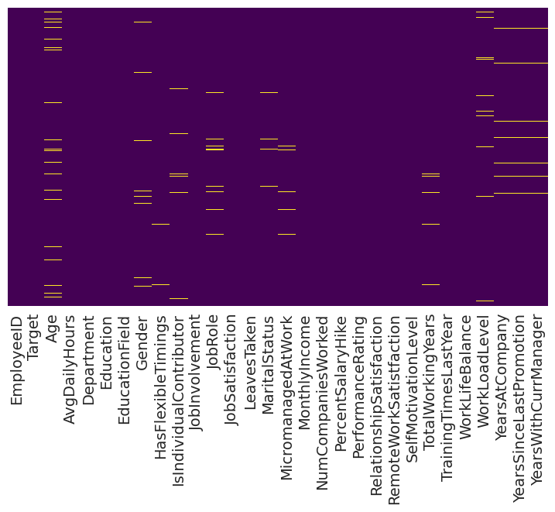
IMPLEMENTATION
Heat map of null values in the dataset

Slide 13
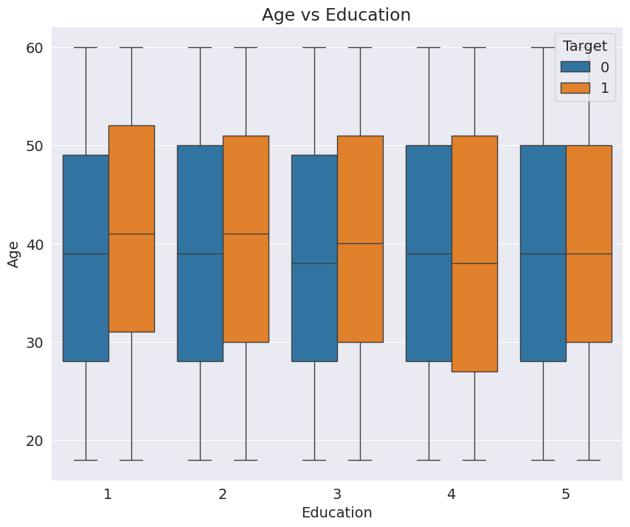
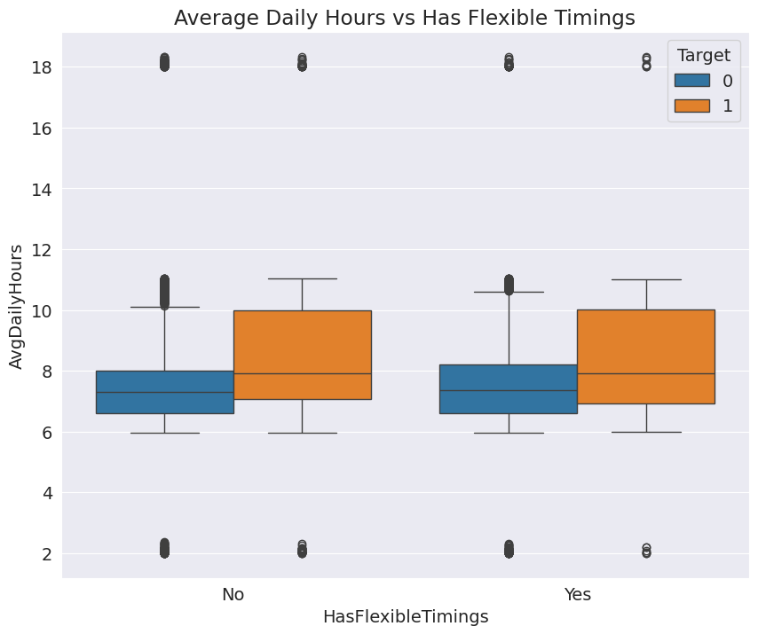
At every educational level, individuals aged between 35 to 50 demonstrate a higher susceptibility to stress.
Employees with flexible schedules may still experience stress if they work more than 8 hours per day.

Slide 14
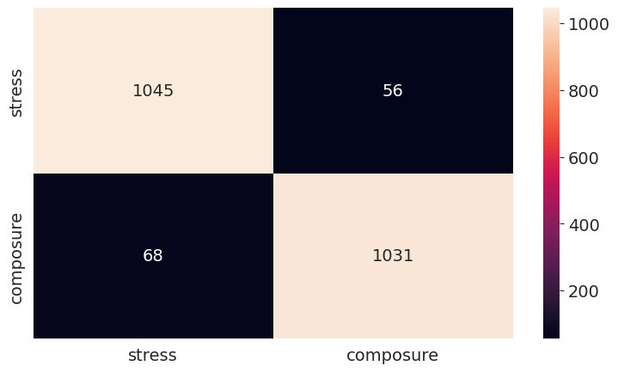
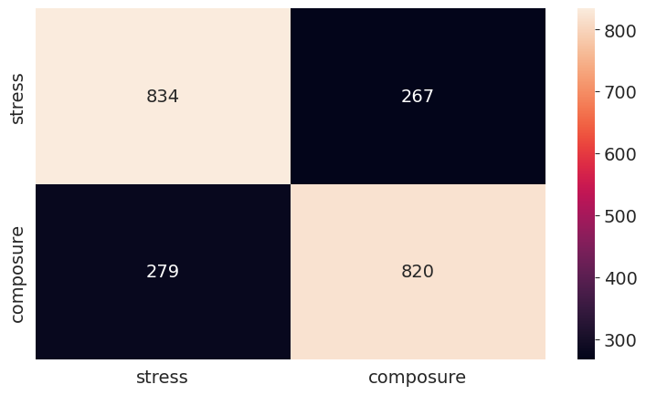
The confusion matrix for the Random Forest algorithm is as follows, with an accuracy score of 0.943636.
The confusion matrix for the KNN algorithm is as follows, with an accuracy score of 0.751818.

Slide 15
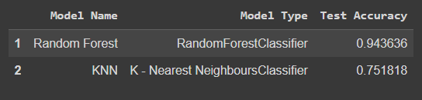
The table demonstrates that the random forest classifier achieves a higher test accuracy (0.94) compared to the KNN classifier (0.75).

Slide 16
INTERPRETATION
K-Nearest Neighbours (KNN) Classifier achieved a test accuracy of 75.18%, indicating a lower performance compared to RandomForestClassifier.
The lower accuracy of KNN suggests challenges in accurately capturing underlying patterns, potentially due to suboptimal hyperparameters or limitations in handling high-dimensional data.
RandomForestClassifier demonstrated a significantly higher test accuracy of 94.36%, indicating its effectiveness in capturing complex patterns within the dataset.
The high test accuracy of RandomForestClassifier reflects its robustness and generalization capabilities, making it suitable for predictive modeling in the context of employee mental health.

Slide 17
CONCLUSION
RandomForestClassifier outperformed K-Nearest Neighbours (KNN) Classifier in predicting employee mental health status with a 94.36% test accuracy versus 75.18%, emphasizing the former's efficacy.
The findings underscore the significance of algorithm selection and parameter optimization in workplace mental health prediction. RandomForestClassifier excels in identifying at-risk individuals, while KNN Classifier provides additional insights.

Slide 18
FUTURE WORK
Developing a user-friendly online platform with a self-assessment tool for stress and mental health evaluation, along with personalized recommendations, can greatly enhance employee well-being.

Slide 19
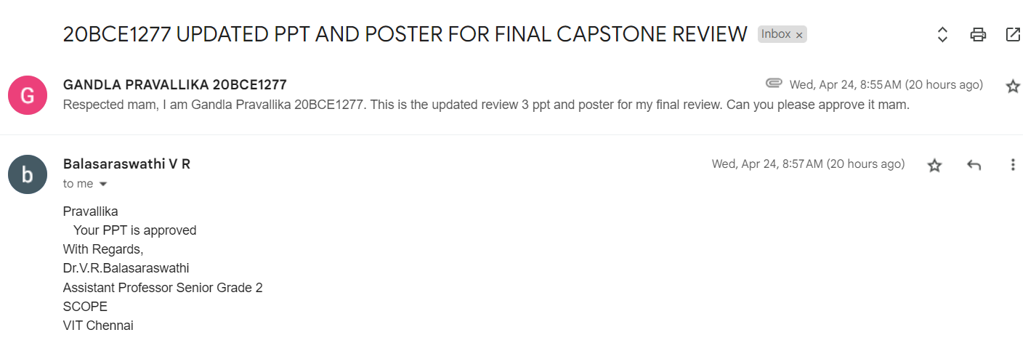
GUIDE APPROVAL SNAPSHOT

Slide 20
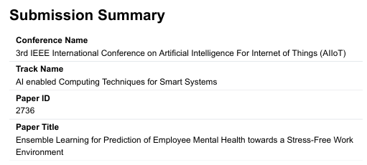
RESEARCH PAPER STATUS
I have finished my research paper, and my guide has submitted it to the journals.

Slide 21
REFERENCES
[1] Lazarus, R. S., & Folkman, S. (1984). Stress, appraisal, and coping. Springer publishing company.
[2] Trougakos, J. P., & Hideg, I. (2009). Momentary work recovery: The role of within-day work breaks. In Current perspectives on job-stress recovery (pp. 37-84). Emerald Group Publishing Limited.
[3] Reddy, U. S., Thota, A. V., & Dharun, A. (2018, December). Machine learning techniques for stress prediction in working employees. In 2018 IEEE International Conference on Computational Intelligence and Computing Research (ICCIC) (pp. 1-4). IEEE.
[4] Yatbaz, H. Y., & Erbilek, M. (2020, April). Deep learning based stress prediction from offline signatures. In 2020 8th International Workshop on Biometrics and Forensics (IWBF) (pp. 1-6). IEEE.
[5] Gharleghi, R., Samarasinghe, G., Sowmya, A., & Beier, S. (2020, April). Deep learning for time averaged wall shear stress prediction in left main coronary bifurcations. In 2020 IEEE 17th International Symposium on Biomedical Imaging (ISBI) (pp. 1-4). IEEE.
[6] Gao, W., Lu, X., Peng, Y., & Wu, L. (2020). A deep learning approach replacing the finite difference method for in situ stress prediction. IEEE Access, 8, 44063-44074.
[7] Taylor, S., Jaques, N., Nosakhare, E., Sano, A., & Picard, R. (2017). Personalized multitask learning for predicting tomorrow's mood, stress, and health. IEEE Transactions on Affective Computing, 11(2), 200-213.
[8] Razzak, F., Yi, F., Yang, Y., & Xiong, H. (2019, November). An integrated multimodal attention-based approach for bank stress test prediction. In 2019 IEEE international conference on data mining (ICDM) (pp. 1282-1287). IEEE.
[9] Mirbagheri, M., Jodeiri, A., Hakimi, N., Zakeri, V., & Setarehdan, S. K. (2019, November). Accurate stress assessment based on functional near infrared spectroscopy using deep learning approach. In 2019 26th National and 4th International Iranian Conference on Biomedical Engineering (ICBME) (pp. 4-10). IEEE.

Slide 22
[10] Demmin, D. L., & Silverstein, S. M. (2020). Visual impairment and mental health: unmet needs and treatment options. Clinical Ophthalmology, 4229-4251.
[11] Singh, V., Kumar, A., & Gupta, S. (2022). Mental health prevention and promotion—A narrative review. Frontiers in Psychiatry, 13, 898009.
[12] Chung, J., & Teo, J. (2022). Mental health prediction using machine learning: taxonomy, applications, and challenges. Applied Computational Intelligence and Soft Computing, 2022, 1-19.
[13] Garriga, R., Mas, J., Abraha, S., Nolan, J., Harrison, O., Tadros, G., & Matic, A. (2022). Machine learning model to predict mental health crises from electronic health records. Nature medicine, 28(6), 1240-1248.
[14] Søvold, L. E., Naslund, J. A., Kousoulis, A. A., Saxena, S., Qoronfleh, M. W., Grobler, C., & Münter, L. (2021). Prioritizing the mental health and well-being of healthcare workers: an urgent global public health priority. Frontiers in public health, 9, 679397.
[15] Chancellor, S., & De Choudhury, M. (2020). Methods in predictive techniques for mental health status on social media: a critical review. NPJ digital medicine, 3(1), 43.
RamtinGharleghi, GihanSamarasinghe, ArcotSowmya, Susann Beier,”Deep Learning For Time Averaged Wall Shear Stress Prediction In Left Main Coronary Bifurcations”,2020
[11] Wenli Gao, Xinming Lu, Yanjun Peng, And Liang Wu,”A Deep Learning Approach Replacing the Finite Difference Method for In situ Stress Prediction”,2020
[12] Sara Taylor, Natasha Jaques, EhimwenmaNosakhare, Akane Sano, and Rosalind Picard”Personalized Multitask Learning for Predicting Tomorrow’s Mood, Stress, and Health”,2020
[13] FaridRazzak, Fei Yi, Yang Yang, Hui Xiong”An Integrated Multimodal Attention-Based Approach for Bank Stress Test Prediction”,2019
[14] MahyaMirbagheri, Ata Jodeiri, NaserHakimi, VahidZakeri, SeyedKamaledinSetarehdan”MahyaMirbagheri, Ata Jodeiri, NaserHakimi, VahidZakeri, SeyedKamaledin Setarehdan”,2019
[15] RamtinGharleghi, GihanSamarasinghe, ArcotSowmya, Susann Beier,”Deep Learning For Time Averaged Wall Shear Stress Prediction In Left Main Coronary Bifurcations”,2020
[16] Wenli Gao, Xinming Lu, Yanjun Peng, And Liang Wu,”A Deep Learning Approach Replacing the Finite Difference Method for In situ Stress Prediction”,2020.

Slide 23
THANK YOU

